Slide 1
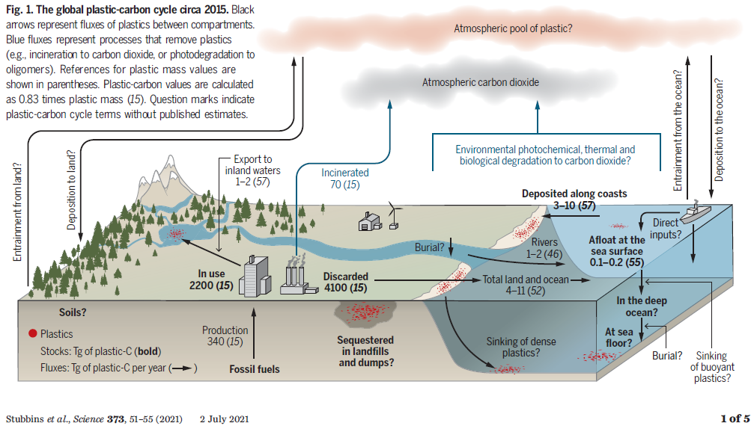
Stubbins et al., 2021 Science: « Plastics in the Earth System »

Slide 2
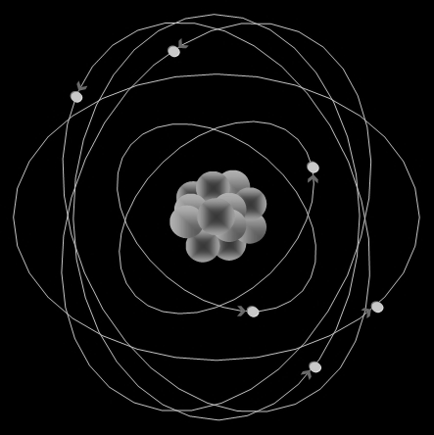

GLOBAL PLASTICS CYCLE FOR THE YEAR 2015
Atmosphere sMP 0.031
7.6
8.6
0.09
0.1
CO₂ 700
0.18
2.0
74
Surface Ocean sMP 0.003
Disc sMP 1100
0.006
0.07
372
1E-4
5
Natural soil
sMP 29
MP
0.04
Beach MP 0.5
7E-4
0.13
Disc MP 1400
42
0.12
0.07
21
P
0.23
0.35
3E-3
In-Use P
2600
Beach P 3.9
0.04
0.8
0.07
0.5
P: macroplastics >5mm
MP: microplastics 0.3 to 5mm
sMP: small microplastics <0.3mm
All reservoir masses in Tg
All fluxes (arrows) in Tg y⁻¹)
Observations (black), modeled (red)
Deep Ocean
sMP+MP 82
118
Shelf sediments
sMP+MP: 0.001?
Discarded P
3500
?
57
Deep ocean
Sediments ?

Slide 3
GLOBAL PLASTICS CYCLE FOR THE YEAR 2015
Brahney et al.,
2021,PNAS
Atmosphere sMP 0.031
7.6
8.6
0.09
0.1
CO₂ 700
0.18
2.0
74
Surface Ocean sMP 0.003
Disc sMP 1100
0.006
0.07
372
1E-4
5
Natural soil
sMP 29
MP
0.04
Beach MP 0.5
7E-4
0.13
Disc MP 1400
42
0.12
0.07
21
P
0.23
0.35
3E-3
In-Use P
2600
Beach P 3.9
0.04
0.8
0.07
0.5
Ocean:
Eriksen 2014 Plos-One
Rivers:
Jambeck 2015, Science
Weiss 2021,
Science
P: macroplastics >5mm
MP: microplastics 0.3 to 5mm
sMP: small microplastics <0.3mm
All reservoir masses in Tg
All fluxes (arrows) in Tg y⁻¹)
Observations (black), modeled (red)
Deep Ocean
sMP+MP 82
118
Shelf sediments
sMP+MP: 0.001?
Discarded P
3500
?
57
Deep ocean
Sediments ?
Discarded pool: urban, industrial, agricultural, landfills, impacted rivers+wetlands
Geyer et al., 2017, Science: Production (8300 Tg), use and fate of all plastics ever made
Notes:
All boxes and arrows are draw to scale except soils and sediments

Slide 4
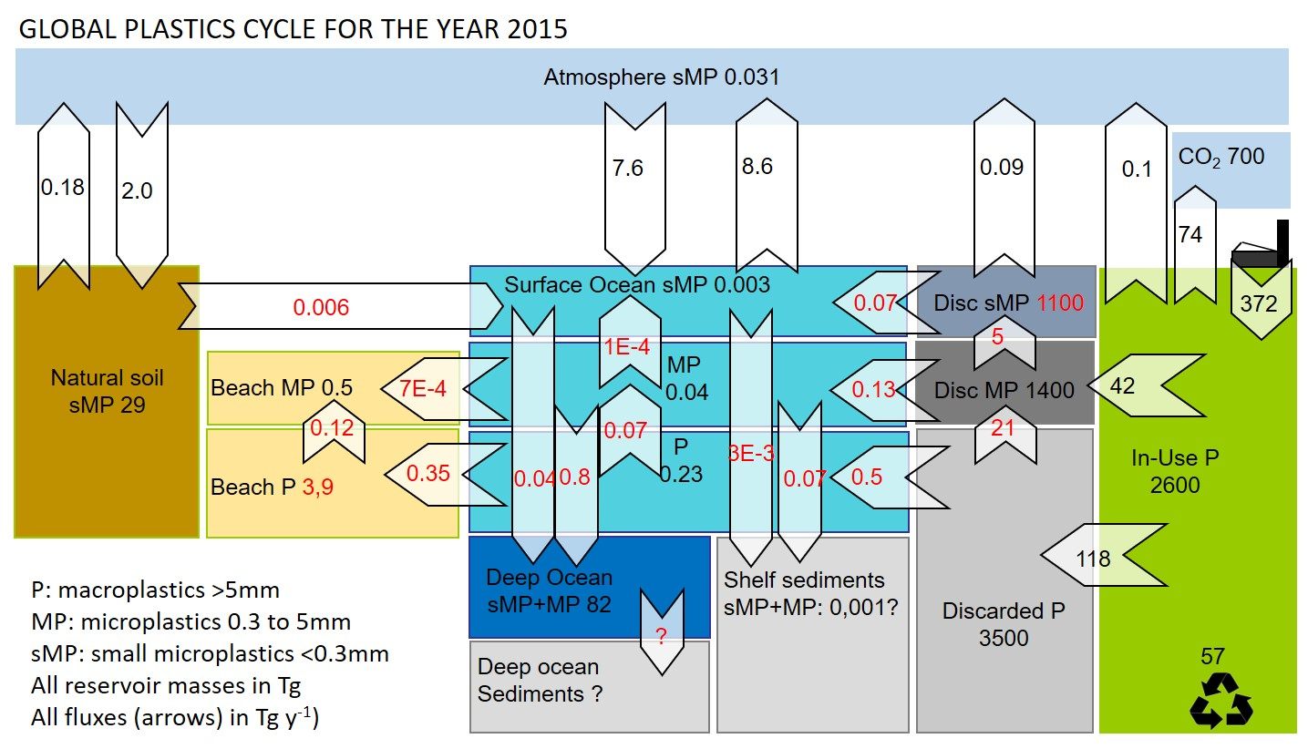
The missing Ocean plastics paradox
Surface Ocean floating plastic debris: 0.3 Tg (Mt, millions of tons; Eriksen et al., Plos-One, 2014). River plastics flux: 5-13 Tg/y (Jambeck et al., Science 2015)
Where did all the plastics go?
Fragmentation, then sinking to deep ocean and sediments (Lebreton et al., 2019, SciRep)
Beaching: Koelmans 2017 ; Onink, Koelmans, Env.Res.Lett 2021
Atmosphere: 8.6 Tg/y, Brahney et al., 2020, PNAS
River budget wrong: Weiss et al., 2021, Science estimate 0.006 Tg/y river flux.
Review data on:
Deep Ocean
Beach P, MP
Sediment P, MP
Remote soils MP
Uncertainty? 10x on all pools and fluxes

Slide 5
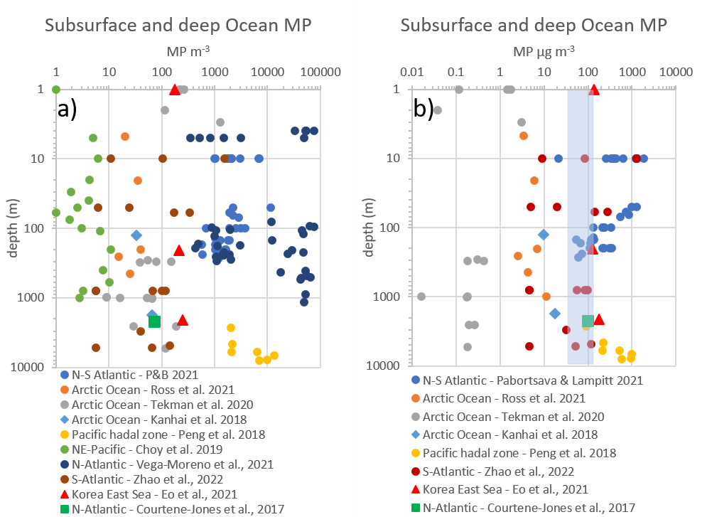
# to mass conversion is extremely critical and uncertain: V=L³*0.1 or V=4/3pi*r³
Need to consider full size and # distribution (including non-observed particles)
Most mass is in the larger, less abundant MP

Slide 6
Ocean basin | Location | depth | MP+sMP | Reference
 |  | m | µg m⁻³
N-Pacific | Korean East Sea | 206 | 125 | (Eo et al., 2021)
N-Pacific | Korean East Sea | 2100 | 177 | (Eo et al., 2021)
N-Pacific | Marian Trench | 2673 | 90 | (Peng et al., 2018)
mean |  |  | 131
1σ |  |  | 44
N- and S-Atlantic | -53º S to 47º N | 160 | 134 | (Pabortsava and Lampitt, 2020)
N-Atlantic | Rockall Trough | 2200 | 97 | (Courtene-Jones et al., 2017)
S-Atlantic | Gyre |  | 43 | (Zhao et al., 2022)
mean |  |  | 91
1σ |  |  | 46
Arctic Ocean | Central basin | 5 to 1000 | 6 | (Ross et al., 2021)
Arctic Ocean | Central basin | 1769 | 66 | (Kanhai et al., 2018)
Arctic Ocean | Fram Strait | 300 to 5570 | 0.2 | (Tekman et al., 2020)
mean |  |  | 24
1 σ |  |  | 36

Slide 7
Ocean basin | Area | Volume | MP+sMP | MP+sMP | 1σ
 | km² | km³ | µg m⁻³ | Tg | Tg
Arctic Ocean | 15558000 | 18750000 | 24 | 0.4 | 0.6
North Atlantic | 41490000 | 146000000 | 91 | 13.0 | 3.0
South Atlantic | 40270000 | 160000000 | 91 | 14.3 | 3.3
Indian Ocean | 70560000 | 264000000 | 43 | 11.0 | 11.0
North Pacific | 77010000 | 331000000 | 131 | 42.2 | 14.1
South Pacific | 84750000 | 329000000 | 4 | 1.2 | 12.0
Southern Ocean | 21960000 | 71800000 | 4 | 0.3 | 3.0
Total |  |  |  | 82 | 47

Slide 8
GLOBAL PLASTICS CYCLE FOR THE YEAR 2015
Atmosphere sMP 0.031
7.6
8.6
0.09
0.1
CO₂ 700
0.18
2.0
74
Surface Ocean sMP 0.003
Disc sMP 1100
0.006
0.07
372
1E-4
5
Natural soil
sMP 29
MP
0.04
Beach MP 0.5
7E-4
0.13
Disc MP 1400
42
0.12
0.07
21
P
0.23
0.35
3E-3
In-Use P
2600
Beach P 3.9
0.04
0.8
0.07
0.5
P: macroplastics >5mm
MP: microplastics 0.3 to 5mm
sMP: small microplastics <0.3mm
All reservoir masses in Tg
All fluxes (arrows) in Tg y⁻¹)
Observations (black), modeled (red)
Deep Ocean
sMP+MP 82
118
Shelf sediments
sMP+MP: 0.001?
Discarded P
3500
?
57
Deep ocean
Sediments ?
Blue circles: mass inventories that need work (I did not easily find publications)
Note: many papers on agricultural soils, but included here in ‘discarded’ pool

Slide 9
1 Budget, 2 Box model: simulate historical and future fluxes and pool size
How?
Simple box model, assuming first order mass transfer:
The flux (Tg/y) of MP out of a box is proportional to the mass of MP (Tg) in the box:
F=k x M where k = constant
F_{oce→atm} = d(MP_{oce})/dt = k x MP_{oce}
k = is time-invariant first order mass transfer coefficient (units 1/y, similar to a kinetic rate constant)

Slide 10
1 Budget, 2 Box model: simulate historical and future fluxes and pool size
F_{oce→atm} = d(MP_{oce})/dt = k x MP_{oce} = ordinary differential equation (ODE), 13 total
Analytical solution? Numerical solution/model?
Explicit, forward time finite difference approximation, in Excel, chose dt=0.001 y (300k iterations):
(MP_{oce})^{t+1} - (MP_{oce})^{t} = dt x k x (MP_{oce})^{t}
(MP_{oce})^{t+1} = (MP_{oce})^{t} + dt x k x (MP_{oce})^{t}
Or use an ODE solver in python (matlab or R)
Model is forced by production, waste data (Geyer17), and k values? How to know k’s?

Slide 11
How to know k values?
F=k x M where k = constant 1/y and Tg/y = 1/y x Tg
k=F/M at all time steps, so look at 2015 budget above
Example: Discarded P pool = 3500 Tg; river P flux = 5 Tg/y; then k = 5/3500 (y⁻¹)
Some k’s are not known; need to make assuptions. Example P to MP fragmentation; Lebreton19 proposed 0.03 y⁻¹ for the ocean. Assume same k for P fragmentation in beach, discarded pools. Then see what happens…

Slide 12
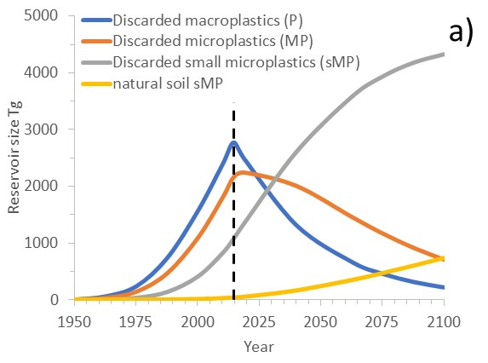
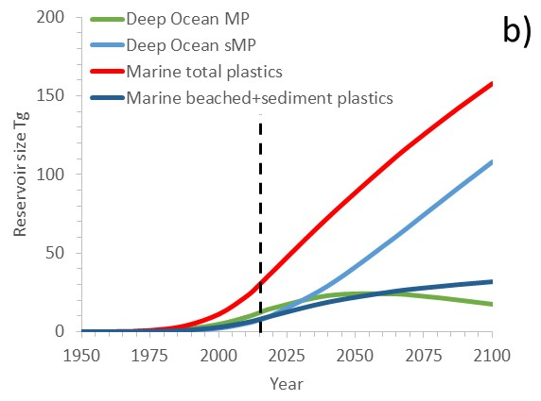
What happens if we stop P production and pollution in 2015? For how long will legacy P pollution propagate through reservoirs and impact ecosystems?

Slide 13
What action should be take to avoid P, MP, sMP propagation through reservoirs? Ocean clean-up? Stop primary MP use and waste? Limit P, MP, sMP leaking from discarded reservoirs?
GLOBAL PLASTICS CYCLE FOR THE YEAR 2015
Atmosphere sMP 0.031
7.6
8.6
0.09
0.1
CO₂ 700
0.18
2.0
74
Surface Ocean sMP 0.003
Disc sMP 1100
0.006
0.07
372
1E-4
5
Natural soil
sMP 29
MP
0.04
Beach MP 0.5
7E-4
0.13
Disc MP 1400
42
0.12
0.07
21
P
0.23
0.35
3E-3
In-Use P
2600
Beach P 3.9
0.04
0.8
0.07
0.5
P: macroplastics >5mm
MP: microplastics 0.3 to 5mm
sMP: small microplastics <0.3mm
All reservoir masses in Tg
All fluxes (arrows) in Tg y⁻¹)
Observations (black), modeled (red)
Deep Ocean
sMP+MP 82
118
Shelf sediments
sMP+MP: 0.001?
Discarded P
3500
?
57
Deep ocean
Sediments ?

Slide 14
TO DO: Python code: Alkuin, Jennie, Jeroen; run diverse scenarios Review data on: Beach P Shelf and deep ocean sediment P, MP Remote soil MP Who?

